Slide 1
UNIIT SIX
PERSONALITY

Slide 2
Defining Some Terms
Personality: A person’s unique and relatively stable behavior patterns; the consistency of who you are, have been, and will become
Character: Personal characteristics that have been judged or evaluated
Temperament: Hereditary aspects of personality, including sensitivity, moods, irritability, and adaptability
Personality Trait: Stable qualities that a person shows in most situations
Personality Type: People who have several traits in common

Slide 3
6.1. Meaning of Personality
Personality has been defined in many different ways, but psychologists generally view personality as :-the unique pattern of enduring thoughts, feelings, and actions that characterize a person.

Slide 4
Cont.
Personality- can be defined as the distinctive and characteristic patterns of thought, emotion, and behavior that make up an individual’s personal style of interacting with the physical and social environment.
Personality - A relatively stable set of characteristics that influences an individual’s behavior

Slide 5
Cont.
Personality is the pattern of enduring characteristics that produce consistency and individuality in a given person.
It encompasses the behaviors that make each of us unique and that differentiate us from others.
It is also personality that leads us to act consistently in different situations and over extended periods of time.

Slide 6

6.2. Theories of Personality
Psychoanalytic Theory
Trait Theory
Humanistic Theory

Slide 7
6.2.1. The psychoanalytic theory of personality
Freud’s Psychoanalytic Theory of Personality: Mapping the Unconscious Mind
Sigmund Freud, an Austrian physician, developed psychoanalytic theory in the early 1900s.
According to Freud’s theory, conscious experience is only a small part of our psychological makeup and experience.
He argued that much of our behavior is motivated by the unconscious, a part of the personality that contains the memories, knowledge, beliefs, feelings, urges, drives, and instincts of which the individual is not aware.

Slide 8
Cont.
According to Freud, personality is formed within ourselves, arising from basic inborn needs, drives, and characteristics.
Psychodynamic Theories: Focus on the inner workings of personality, especially internal conflicts and struggles
He argued that people are in constant conflict between their biological urges (drives) and the need to tame them.

Slide 9
STRUCTURING PERSONALITY
In Freud's view, personality has three parts which serves a different function and develops at different times:
Id - Unconscious
Ego - unconscious, preconscious, conscious
Superego - unconscious, preconscious, conscious
According to Freud, the way these three parts of personality interact with one another determines the personality of an individual.

Slide 10
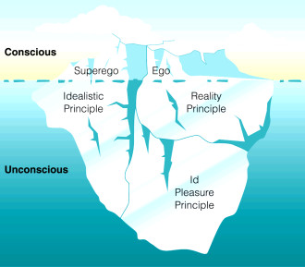
Psychoanalytic Personality Structure
Freud’s “iceberg” idea of the mind’s structure
Abstract concepts for understanding the mind’s conflicts between pleasure-seeking and social restraint
Preconscious

Slide 11
Freud’s Psychoanalysis: The Id
Operates according to the pleasure principle
Present from birth
Unorganized, inborn part of personality whose purpose is to immediately reduce tensions relating to primitive impulses such as hunger, sex, aggression
competing instincts:
Life (sexual) - libido
Death (aggressive)
Unconscious

Slide 12
Freud’s Psychoanalysis: The Ego
Operates according to the reality principle
Arises in first 3 years of life
Mediates between Id and Superego
Rational part of mind
you can’t always get what you want
Floats between all 3 levels of consciousness (Conscious, pre-conscious & unconscious)

Slide 13
Freud’s Psychoanalysis: The Superego
Moral Conscience
Develops around age 5
At end of Phallic Stage
Stores and enforces rules
Inner voice that tells you not to do something or that what you did was wrong
subsystems:
Ego Ideal = parents approve/value
Conscience = parents disapproval

Slide 14
DEVELOPING PERSONALITY: PSYCHOSEXUAL STAGES
Freud also provided us with a view of how personality develops through a series of five psychosexual stages, during which individuals encounter conflicts between the demands of society and their own sexual urges (in which sexuality is more about experiencing pleasure and less about lust).
According to Freud, failure to resolve the conflicts at a particular stage can result in fixations, conflicts or concerns that persist beyond the developmental period in which they first occur.
Such conflicts may be due to having needs ignored or (conversely) being overindulged during the earlier period.

Slide 15
The sequence Freud proposed is noteworthy because it explains how experiences and difficulties during a particular childhood stage may predict specific characteristics in the adult personality.
This theory is also unique in associating each stage with a major biological function, which Freud assumed to be the focus of pleasure in a given period.
In the first psychosexual stage of development, called the oral stage, the baby’s mouth is the focal point of pleasure.
During the first 12 to 18 months of life, children suck, eat, mouth, and bite anything they can put into their mouths.

Slide 16
To Freud, this behavior suggested that the mouth is the primary site of a kind of sexual pleasure, and that weaning/ discouraging (withdrawing the breast or bottle) represents the main conflict during the oral stage.
If infants are either overindulged (perhaps by being fed every time they cry) or frustrated in their search for oral gratification, they may become fixated at this stage.
For example, fixation might occur if an infant’s oral needs were constantly gratified immediately at the first sign of hunger, rather than if the infant learned that feeding takes place on a schedule because eating whenever an infant wants to eat is not always realistic.

Slide 17
Fixation at the oral stage might produce an adult who was unusually interested in oral activities—eating, talking, smoking—or who showed symbolic sorts of oral interests: being either “bitingly” sarcastic such as fingernail biting or very gullible (“swallowing” anything).
From around age 12 to 18 months until 3 years of age—a period when the emphasis in Western cultures is on toilet training—a child enters the anal stage.
At this point, the major source of pleasure changes from the mouth to the anal region, and children obtain considerable pleasure from both retention and expulsion of feces.

Slide 18
If toilet training is particularly demanding, fixation might occur.
Fixation during the anal stage might result in unusual rigidity, orderliness, punctuality, over neatness—or extreme disorderliness or sloppiness/ messy, dirtiness—in adulthood.
At about age 3, the phallic stage begins. At this point there is another major shift in the primary source of pleasure for the child.
Now interest focuses on the genitals and the pleasures derived from fondling/ manipulating them.
According to Freudian theory, as children focus attention on their genitals, the differences between male and female anatomy become more salient/ noticeable.

Slide 19
During this stage the child/ boy must also negotiate one of the most important hurdles of personality development: the Oedipal conflict.
According to Freud, at this time the male unconsciously begins to develop a sexual interest in his mother, starts to see his father as a rival, and harbors a wish to kill his father—as Oedipus did in the ancient Greek tragedy.
But because he views his father as too powerful, he develops a fear that his father may retaliate drastically by removing the source of the threat: the son’s penis.

Slide 20
The fear of losing one’s penis leads to castration anxiety, which ultimately becomes so powerful that the child represses his desires for his mother and identifies with his father.
Identification is the process of wanting to be like another person as much as possible, imitating that person’s behavior and adopting similar beliefs and values.
By identifying with his father, a son seeks to obtain a woman like his unattainable mother.

Slide 21
For girls, the process is different. Freud reasoned that girls begin to experience sexual arousal toward their fathers & hate their mothers(Electra complex) and begin to experience penis envy.
They wish they had the anatomical part that, at least to Freud, seemed most clearly “missing” in girls.
Blaming their mothers for their lack of a penis, girls come to believe that their mothers are responsible for their “castration.” (This aspect of Freud’s theory later provoked accusations that he considered women to be inferior to men.)

Slide 22
Like males, though, they find that they can resolve such unacceptable feelings by identifying with the same-sex parent, behaving like her and adopting her attitudes and values.
In this way, a girl’s identification with her mother is completed.
At this point, the Oedipal conflict is said to be resolved, and Freudian theory assumes that both males and females move on to the next stage of development.
If difficulties arise during this period, however, all sorts of problems are thought to occur, including improper sex-role behavior and the failure to develop a conscience.

Slide 23
After the resolution of the Oedipal and Electra conflicts, typically at around age 5 or 6, children move into the latency period, which lasts until puberty.
During this period, sexual interests become dormant, even in the unconscious.
Then, during adolescence, sexual feelings reemerge, marking the start of the final period, the genital stage, which extends until death.
The focus during the genital stage is on mature, adult sexuality, which Freud defined as sexual intercourse.

Slide 24
Freud’s Psychoanalysis: Defense mechanisms
Defense mechanism reduce/redirect anxiety by distorting reality
Denial:- Most primitive; refusing to believe, denying reality; usually occurs with death and illness.
- claiming and believing that something which is actually true
is false.
2. Repression : - pushing unacceptable and anxiety-producing
thoughts into the unconscious; involves intentional forgetting but not consciously done; repressed material can be memories or unacceptable impulses.
Projection :- attributing one’s own unacceptable feelings or beliefs to others;
Example :- An employee at a store, tempted to steal some merchandise, suspects that other employees are stealing.

Slide 25
Cont.
4. Rationalization : -Justifying personal actions by giving “rational” but false reasons for them
5. Reaction Formation: Impulses are repressed and the opposite behavior is exaggerated.
- replacing an anxiety-producing feeling with its exact opposite, typically going overboard; repressed thoughts appear as mirror opposites.
6.Regression: involves reverting to immature behaviors that have relieved anxiety in the past.
-acting in ways characteristic of earlier life stages of personality
Example: a girl/a boy who has just entered school may go back to sucking her/his thumb or wetting the bed.

Slide 26
Cont.
7. Displacement: -expressing feelings toward a person who is less threatening than the person who is the true target of those feelings.
Example:- A husband, angry at the way his boss treated him, screams at his children.
8. Sublimation: substitute socially acceptable behavior for unacceptable impulses.
Playing video games instead of getting in a fight.

Slide 27
6.2.2. The trait theory of personality
Trait Theory - understand individuals by breaking down behavior patterns into observable traits
The trait approach to personality makes three main assumptions:
1. Personality traits are relatively stable, and therefore
predictable, over time.
2. Personality traits are relatively stable across
situations.
3. People differ in how much of a particular personality
trait they possess; no two people are exactly alike on all traits. The result is an endless variety of unique personalities.

Slide 28
The “Big Five” Personality Factors
Openness to Experience
Conscientious
Extroversion
Agreeableness
Neuroticism

Slide 29
The five-factor model / the Big Five theory (OCEAN)
1. Openness to experience:- refers to a person‘s willingness to try new things and be open to new experiences
Open = Curiosity, imaginative, creative
Resistant = Conforming, predictable
Conscientiousness :- refers the tendency to control impulse and act in socially acceptable ways
Conscientious = Responsible, persevering, self-disciplined
Impulsive = Quick to give up, fickle, careless
3. Extroversion:- divided into two personality types
Extroversion = Outgoing – talkative, sociable, adventurous
Introversion = Shy – silent, reclusive, cautious

Slide 30
Cont.
4. Agreeableness:-refers to the basic emotional style of a person.
Agreeable = Good-natured, cooperative, secure
Antagonistic = Irritable, abrasive, suspicious, jealous
5. Neuroticism:- refers to emotional instability or stability.
Neurotic = anxious, impulsive, worrier, emotionally negative
Emotionally stable = only has those feelings when the circumstances dictate

Slide 31
6.2.3. Humanistic theory of personality (Carl Rogers and Abraham Maslow )
Humanistic Theories: Focus on private, subjective experience and personal growth
Humans are free and basically good.
Humans are inner-directed.
Everyone has the potential for healthy growth.
Health growth involves Self actualization:
Given the right environmental conditions, we can reach our full potential

Slide 32
Cont.
Congruence :- this is displayed by fully functioning people and is a harmony between the image they project to others and their true feelings or wishes.
To become fully functioning we need:
Unconditional positive regard
A situation in which the acceptance and love one receives from significant others is unqualified, no strings attached

Slide 33
Cont.
Fully Functioning Person: Lives in harmony with his/her deepest feelings and impulses
Self: Flexible and changing perception of one’s identity
Self-Image: Total subjective perception of your body and personality
Incongruence: Exists when there is a discrepancy between one’s experiences and self-image
Positive Self-Regard: Thinking of oneself as a good, lovable, worthwhile person
Unconditional Positive Regard: Unshakable love and approval

Slide 34
Components of the self-concept
Self-concept: our image or perception of ourselves.
1. The real self (one‘s actual perception of characteristics, traits, and abilities that form the basis of the striving for self-actualization) and
2. The ideal self (the perception of what one should be or would like to be). e.g. From parents.

Slide 35
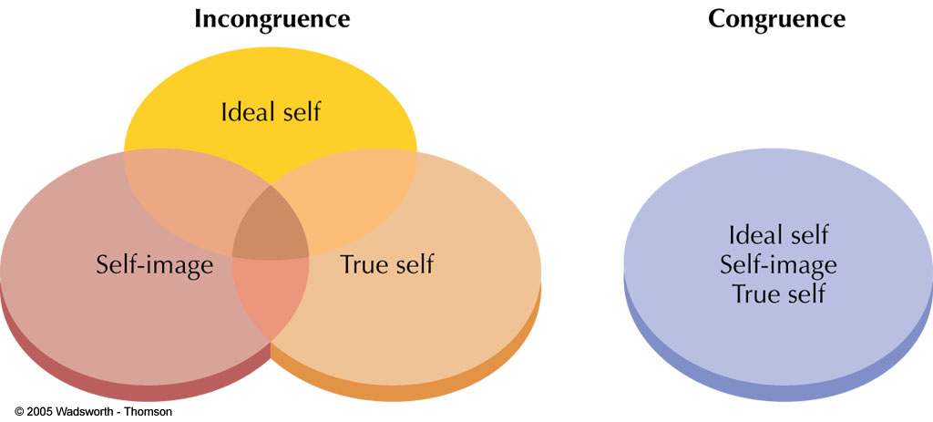
Cont.
Incongruence occurs when there is a mismatch between any of these three entities: the ideal self (the person you would like to be),
self-image (the person you think you are), and
the true self (the person you actually are). Self-esteem suffers when there is a large difference between one’s ideal self and self-image. Anxiety and defensiveness are common when the self-image does not match the true self.

